Slide 1

2017 and 2018 - 2020
Association of Professional Administrators Agreement(s)

Slide 2
6-Month Successor Agreement
Memorandum of Agreement:
The provisions of the 2014-2016 Agreement shall be incorporated into the 2017 Agreement except as the former are amended by the following provisions.
The 2017 Agreement will include all additional Memoranda of Agreement and Memoranda of Understanding entered into by the parties since the 2014-2016 Agreement was reached, subject to any agreements otherwise made.
Changes in dates and nomenclature will be made as necessary to preserve the meaning of the 2014-2016 Agreement. Additional changes may be required in order to reconcile related provisions.

Slide 3
Why we asked for the 6-Month Successor and what it means:
These negotiations sessions began in October of 2016 (APA Contract expired on December 31, 2016)
October 2016 was when we could first get Management to begin talks (we began asking for meetings in the Summer of 2016)
MSCA Contract was expiring on June 30, 2017. There were no “parameters” to set for the coming APA contract – Management likes to wait until MSCA is ready to begin bargaining before serious talks with APA
We have been asking to get on to the same schedule as MSCA during the last three contract bargaining seasons.
We have finally achieved that goal - using a 6-month extension and then a 3-year contract

Slide 4
Benefit to members:
The BHE would not agree to any additional funding for APA members in the 6-month successor agreement, however….
The Council of Presidents agreed to compensation of .05% - in two payments to all APA members who were employed as of February 28, 2018 (the day we reached tentative agreement) or who retired between January 1, 2017 and February 28, 2018, for a total of one-half of one percent of their annual salary as is was on February 28th.
These payments (which do not increase the member’s base salary) will be made within 30 days of Contract Ratification (.25%) and again on the first payroll period after July 1, 2018 (.25%).
The 1% retroactive increase that will be due to members going back to July 1, 2017 will be factored into the calculation of the payments to members.

Slide 5
Council of Presidents/APA
Memorandum of Agreement
Within four weeks of ratification of the terms of the 2017-2020 collective bargaining agreement, the Universities shall initiate payment to each bargaining unit member employed as of February 28, 2018, and all former bargaining unit members who left employment in order to retire under the State Retirement Program or who left employment to begin receiving distributions under the ORP between January 1, 2017 and February 28, 2018, a payment for purposes of professional development equivalent to .25% (one-quarter of one percent) of their annual salary as it was on February 28, 2018 or when the unit member was last employed.
In the first payroll period after July 1, 2018, the Universities shall provide each bargaining unit member employed as of July 1, 2018 and all former bargaining unit members who left employment in order to retire under the State Retirement Program or who left employment to begin receiving distributions under the ORP between January 1, 2017 and July 1, 2018, a professional development payment equivalent to .25% (one-quarter of one percent) of their annual salary as it was on February 28, 2018.

Slide 6
APA Agreement 2018-20
Terms of the new Agreement run from July 1, 2017 – June 30, 2020
Agreement was reached on February 28th, 2016
MOA was finalized on April 11, 2018
Parameters (what the Governor and DHE were willing to offer for salary increases) were not delivered to the Bargaining Tables until April 2017
All State Unions received the same financial offer
Virtually all state unions held off from agreeing to the parameters (attempting to negotiate better numbers and terms
Local 509 and SEIU units were the first to agree to terms in January 2018 – ratified on February 1, 2018 – blazing the way for other State Unions to settle.

Slide 7
Changes – Article V … Salary pg33
July 1, 2017: a 1% retroactive across the board increase to all bargaining unit members employed as of April 1, 2017 and to all former bargaining unit members who retired between July 1, 2017 and February 28, 2018.
An additional 1% retroactive across the board increase to all bargaining unit members employed as of April 1, 2017 and to all former bargaining unit members who retired between July 1, 2017 and February 28, 2018 if fiscal year 2018 tax revenues equal or exceed $27.072 billion (as defined in Sept. 25, 2017 BHE proposal).
July 1, 2018 a 2% across the board increase to all bargaining unit members employed as of April 1, 2018 and not on a performance improvement plan. The increase will be provided to the employee upon the satisfactory completion of the performance improvement plan.
July 1, 2019 a 2% across the board increase to all bargaining unit members employed as of April 1, 2019 and not on a performance improvement plan. The increase will be provided to the employee upon the satisfactory completion of the performance improvement plan.
Note: Cost of Living Increases are no longer tied to having achieved an overall “competent” on evaluations. However, if an employee is on a PIP – he/she will have to successfully complete that plan in order to receive the increase in salary

Slide 8
Changes – Article III … Workload pg19
Exempt Employees
Hours and Work Schedule. The work schedule of exempt administrators shall be established, in writing, by the employee's Immediate Supervisor and Appropriate Administrative Area Supervisor, or by a person designated by the President, to provide for the performance of the duties of the administrator consistent with the needs of the University and the terms of this Agreement. All full-time, exempt unit members shall account for thirty-seven and one-half (37.5) hours per week, excluding meal periods. However, exempt employees are expected to work beyond this minimum schedule as necessary to accomplish the duties and responsibilities of their exempt position. Exempt employees are not eligible for compensatory time off as defined by the FLSA.
Accounting for Minimum Hours Worked. For purposes of record keeping and pursuant to the direction of the appropriate state regulatory body, exempt employees will account for a minimum of thirty-seven and one-half hours each week.
The University will make pro rata adjustments for those unit members with less than a full-time equivalent position.

Slide 9
Changes – Article III … Workload, cont.
For some positions, the parties acknowledge that there are peak periods of work when an exempt employee will be required to devote an inordinate amount of time to the discharge of the normal duties of the position. The Immediate Supervisor and Appropriate Administrative Area Supervisor, or a person designated by the President, will develop, in writing, such alternate work schedules as they, in their discretion, shall so determine. Such decision shall not be arbitrary or capricious.
The implementation of this provision may be reviewed at least semi-annually at each University pursuant to the consultation provisions of Article II of this Agreement. The parties may utilize the Employee Relations Committee to discuss the application of this Section C.
Nothing in this Section shall operate to impair the authority of the President or Vice President to alter or revoke any alternate work schedule.
The parties believe that a common interpretation of these workload provisions will result in fewer misunderstandings between unit members and their supervisors. The parties will sponsor an orientation meeting for unit members and supervisors and other interested employees upon the conclusion of contract negotiations.

Slide 10
Changes – Article III … Exempt/Non-Exempt Employees
Reflected in the 2018-2020 Agreement there is language proposed and agreed upon in October of 2016 regarding Non-Exempt employees and FLSA regulations
Many campuses implemented changes based on the potential of the FLSA regulations going into effect. The BHE did not reverse changes, so the new language is included in this contract.
A full copy is available for review.

Slide 11
Changes – Article III … Maritime pg21
(a) Replace Cruise Stipend with the following:
The Massachusetts Maritime Academy may require administrators as a term of their employment to serve from time to time on the training ship during cruise, dockside or shipyard status. The parties hereby agree that each administrator who serves aboard the training ship during cruise or shipyard status, on or after January 1, 2018, shall be paid a cruise stipend therefor in the amount of Fifty-Eight Dollars ($58.00) f or each day of cruise or shipyard status. With effect on January 1, 2019, the cruise stipend shall be Sixty Dollars ($60.00) for each day the administrator serves aboard the ship during cruise or shipyard status; provided, however, that no such stipend or portion thereof shall be a part of the base salary rate of any such unit member.

Slide 12
Changes – Article IV … Evaluations pg26
Appendix C (Self-Evaluation document)
APA Bi-Annual Report to Administrative Area Supervisor
Administrator:
Report Due Date: November 1 April 1
Title: Department:
Administrative Area Supervisor:
This report is intended to provide an overview of the work performed during the time period identified above. Work should be consistent with the core job responsibilities of the administrator and aligned with the strategic goals of the administrator’s department and division, as well as the institution. The report should note accomplishments, successes, and/or challenges; provide status updates on current projects, review completed projects, or identify upcoming projects; and report on professional development attended. This report also provides the opportunity to recommend process improvements, efficiencies, or other suggestions to improve student experiences and to achieve strategic goals. Managers and administrators are encouraged to meet and communicate regularly regarding the items noted below.
Accomplishments/successes during this reporting period:
Challenges during this reporting period:
Project update, planning, or review during this reporting period:
Professional development activities – seminars, lunch & learns, lectures, etc. – attended during this reporting period (optional):
Process improvements, efficiencies, or suggestions:
Meeting Notes (if applicable):

Slide 13
Changes – Article IV … Evaluations
Appendix D (APA Annual Performance Narrative Form)
Administrator:
Bi-Annual Reports Received from Administrator: November: April:
Title: Department: Administrative Area Supervisor:
Evaluation Date:
Job Description
Review:
Yes/No If applicable, please submit the updated job description electronically to the Human Resources Office.
It is extremely valuable for managers to evaluate the performance of an administrator. The evaluation of performance enhances the effectiveness of an administrator in making a contribution toward advancing the mission of the department, division, and the institution. Providing regular feedback to an administrator will assist the administrator in performing their core job responsibilities and achieving expectations and goals, as well as help propel the administrator forward in their career.

Slide 14
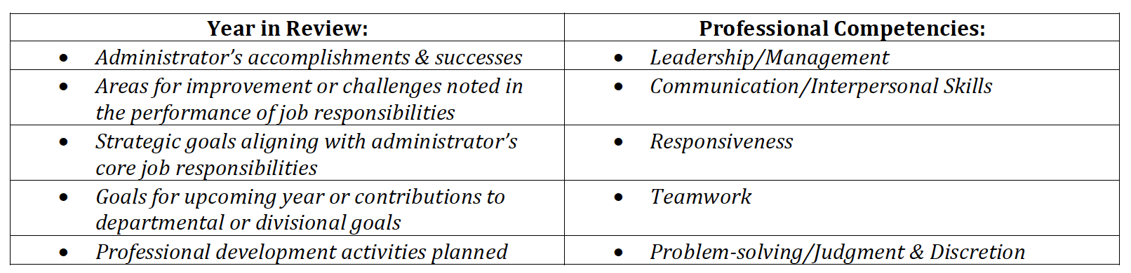
The performance narrative is a tool to review job expectations and strategic goals, assess strengths and weaknesses, identify professional development opportunities, and offer performance feedback to the administrator. The performance narrative should also note overall, whether the administrator has been successful in the performance of their core job responsibilities or if improvement is needed.
The performance narrative should include the following elements when assessing performance:
Job-specific competencies, identified by the manager or supervisor, and the administrator’s job knowledge should also be included in the performance narrative.
It is recommended that the performance narrative be provided to the administrator at least one week in advance of the scheduled meeting to discuss the administrator’s performance. Providing the performance narrative in advance will allow the administrator time to reflect upon the narrative and foster their own thoughts to contribute to the performance discussion in a meaningful way.
Performance Narrative: (Attach document)

Slide 15
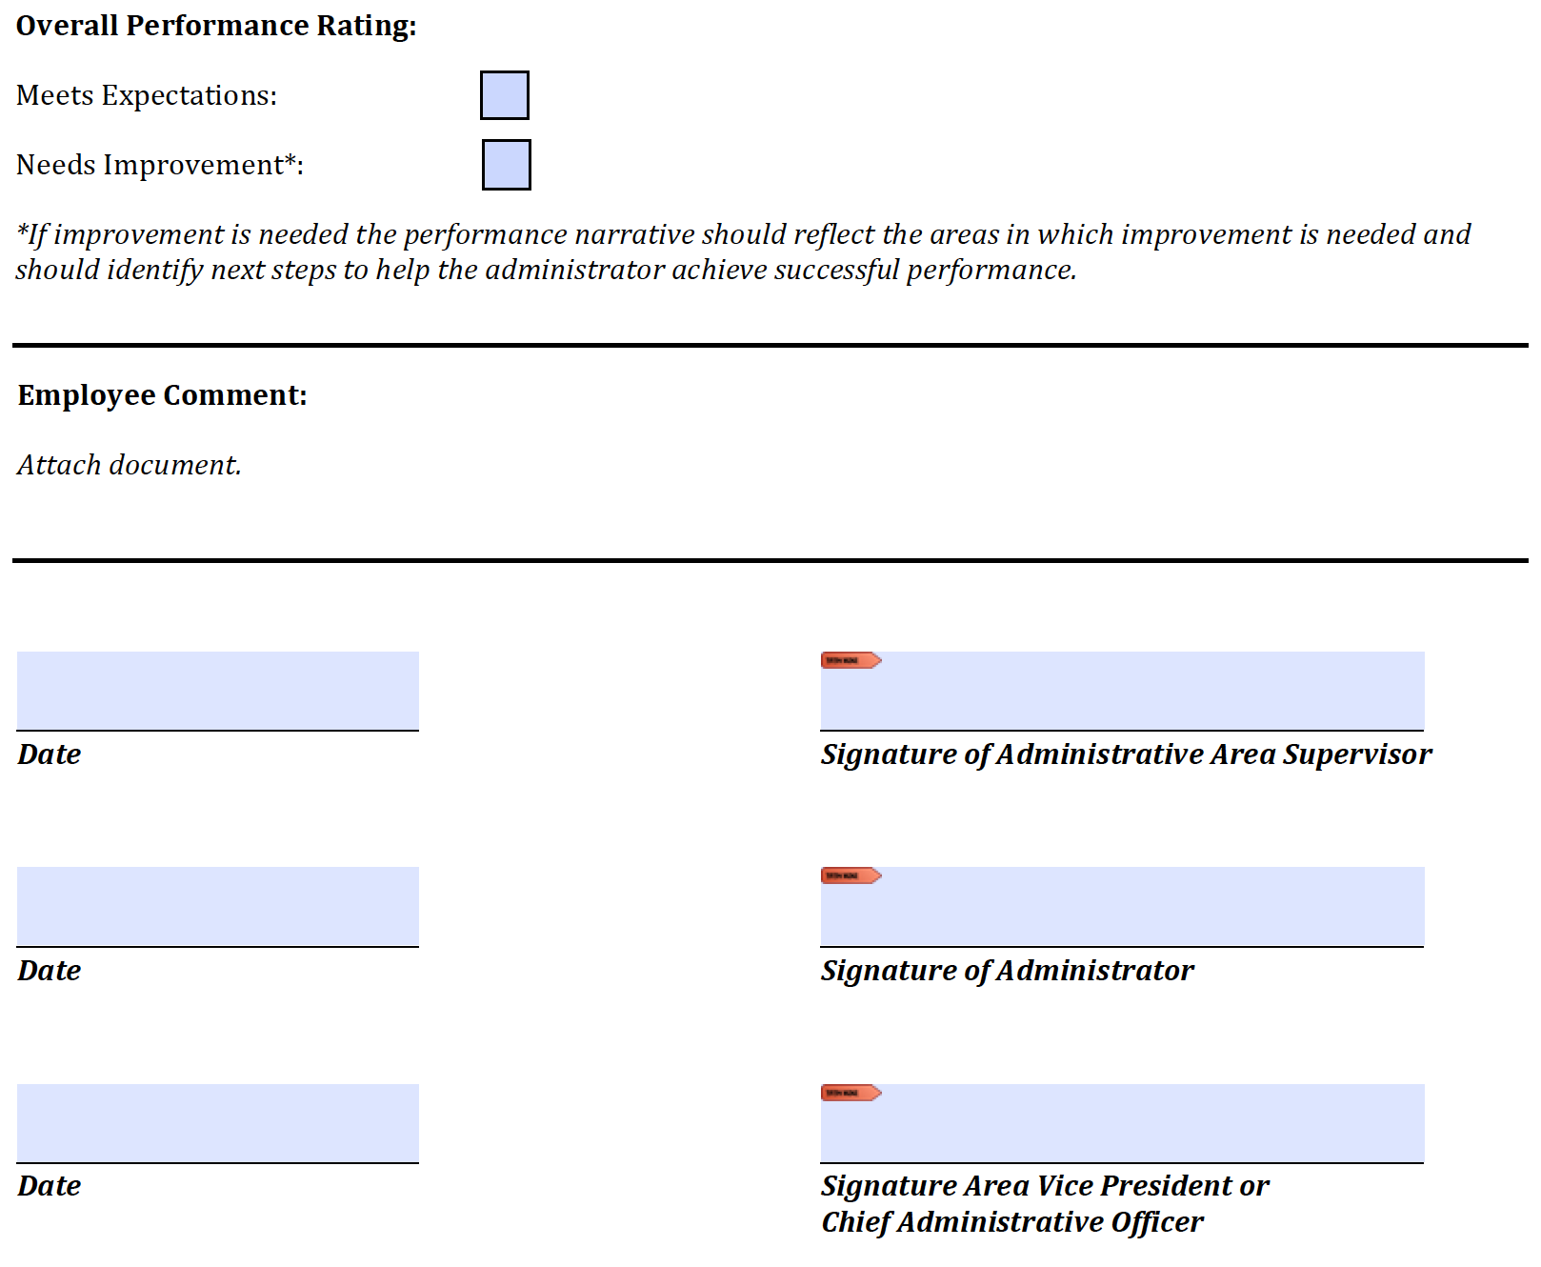
Additionally, Electronic signatures will be a permissible means of executing all evaluation materials.

Slide 16
Changes – Article VI …
Salary Adjustments pg 39
Add the following sentence to Article VI B (2):
Such requests for salary adjustments shall be made at the beginning of the fiscal year budget cycle for the administrator’s institution.

Slide 17
Changes – Article VII …
Bereavement Leave pg46
Leave of absence with pay shall be granted by management to an administrator who suffers the loss by death of a spouse, domestic partner, child or step child for a period not exceeding seven (7) days, and of a parent, step-parent, sibling or step-sibling, aunt, uncle, grandparent, grandchild, or parent of a spouse or person living in the immediate household of either the administrator or of his domestic partner or spouse, for a period not exceeding four (4) days.

Slide 18
Changes – Article VII …
Sick Leave Bank pg49
Access to Sick Leave Bank during FMLA Qualifying Leave for the Birth or Adoption of a Child
The BHE proposes to permit APA unit members who otherwise qualify for FMLA leave due to childbirth or adoption to draw upon the Sick Leave Bank upon the conditions in the labor agreement and those described below. These conditions will be incorporated into a new subsection in Art. VII. Other changes in the Article may be necessary for consistency with this new benefit:
The unit member must be eligible for the sick leave bank and must satisfy eligibility requirements for receiving FMLA leave for childbirth or adoption.
The unit member must first exhaust the all forms of paid leave allowed under the contract.
If both parents are employees of the BHE they may not draw upon the sick leave bank in an amount greater than the amount available to one of them.
Unit members absent due to FMLA leave may not render other services for the BHE or any division of any state university while on leave.

Slide 19
Sick Leave Bank, cont.
Prior to the leave, unit members and the University will sign an agreement that describes these contractual provisions, the terms of the specific absence, what forms of paid leave will be used for the absence and the anticipated date of return to work of the unit member.
Leave pursuant to these provisions may not be taken on an intermittent basis.
If the unit member is on FMLA leave before and after a break (such as a period when the university is closed for any reason or utilizing a skeleton crew) the Bank or the member’s leave entitlement will be charged for the period of the break
The unit member is not required to be off the payroll for 37.5 hours before accessing the Bank pursuant to these provisions
As childbirth and adoption are not illnesses or injuries, the phrase “same illness or injury” shall not include access to the bank pursuant to these provisions.

Slide 20
Changes – Article VII …
Tuition Waiver pg68
Replace third paragraph of Article VII E (1) with the following:
In addition, any member of the bargaining unit who shall have been admitted as a student at any state university or community college in the Commonwealth of Massachusetts shall be entitled to matriculate as a student without the payment of any tuition. Members of the bargaining unit who shall have been admitted in a state-supported course or program at the undergraduate or graduate level in the University of Massachusetts System, excluding the program for the Doctorate of Medicine at the University of Massachusetts Medical School and all programs at the University of Massachusetts Law School, shall be entitled to student tuition credits equal to the value of any tuition waivers, grants or scholarships identified in c. 15 of the General laws or any other General or Special law as determined by the University of Massachusetts.

Slide 21
Tuition Waiver - Note
The APA and the Council of Presidents are working through the COPs Executive Assistant, Vincent Pedone, to consistently allow APA members to attend courses at their home campus – Tuition and Fees waived.
This was most recently discussed at the COP meeting at Westfield State on April 13th. The COP is currently reviewing the practice at all state universities and colleges in order to accommodate the APA’s request for this benefit to our members.

Slide 22
Changes – Article VII … Vacations pg63
i.) With effect upon ratification of this Memorandum of Agreement, vacation leave shall accrue as follows:
From date of employment through four (4) years of service, unit members on active payroll status shall be entitled to twenty (20) days of vacation leave each year, accrued on an hourly basis for each active, standard payroll hour. Time off payroll shall result in the incremental loss of payroll hours of vacation leave awarded.
From five (5) years of service through nine (9) years of service, unit member on active payroll status shall be entitled to twenty-two (22) days of vacation leave each year, accrued on an hourly basis for each active, standard payroll hour. Time off payroll shall result in the incremental loss of payroll hours of vacation leave awarded.
From ten (10) years of service through fourteen (14) years of service, unit member on active payroll status shall be entitled to twenty-three (23) days of vacation leave each year, accrued on an hourly basis for each active, standard payroll hour. Time off payroll shall result in the incremental loss of payroll hours of vacation leave awarded.
From fifteen (15) years of service through nineteen (19) years of service, unit member on active payroll status shall be entitled to twenty-four (24) days of vacation leave each year, accrued on an hourly basis for each active, standard payroll hour. Time off payroll shall result in the incremental loss of payroll hour of vacation leave awarded.
From twenty (20) years of service or more, unit member on active payroll status shall be entitled to twenty-five (25) days of vacation leave each year, accrued on an hourly basis for each active, standard payroll hour. Time off payroll shall result in the incremental loss of payroll hour of vacation leave awarded.
ii) Notwithstanding the above provisions of i), above, the employer shall not reduce the vacation accrual rate of a unit member hired before January 1, 2017, as a result of the implementation of the rate schedule in i). However, all future increases in vacation accrual rates for all unit members as they perform additional years of service will be granted only in accordance with the schedule in i).
iii) Notwithstanding anything above in i) or ii), all unit members who have served twenty five (25) years by June 30, 2020, shall be entitled to vacation leave at the rate of thirty (30) days of vacation leave each year, accrued on an hourly basis for each active, standard payroll hour with effect on their anniversary date, providing the unit member is on active payroll service.
iv) In accordance with the foregoing provisions, any unit member employed on a part-time basis shall be granted that proportion of the vacation leave allowance which his/her service bears to full-time service.

Slide 23
Notes on Vacation/Sick Leave:
Any employee who has already accrued 30 days of vacation leave is grandfathered with 30.
There is NO REDUCTION to sick leave accrual, however, after June 30, 2020 you will no longer be able to roll excess vacation leave (hours greater than 375 accrued) into your sick leave credit.
Current unit members as of the date of the Memorandum of Agreement with accrued vacation credits above fifty (50) days (480 hours) shall have until June 30, 2020 to lower their accrued vacation leave credits to below or equal to a fifty (50) vacation day limit (375 hours). In the last payroll period in June of 2020 the Employer will convert accrued vacation credits in excess of fifty days to sick leave credit. After June 30, 2020, any vacation leave accrual in excess of 375 (fifty 50 days) hours shall be forfeited.

Slide 24
Changes – Article VII …
Vacation Scheduling pg63
Amend Section C, 2 by deleting the existing section and replacing it with the following:
Scheduling of Vacation
Administrators shall request specific dates for the scheduling of their vacations through their Appropriate Administrative Area Supervisor.
Vacation allowance shall be scheduled as a vacation leave at such times as will best serve the needs of the University, the unit member and the public interest. Vacation allowance will be scheduled by the Appropriate Administrative Area Supervisor after consultation with the Chief Administrative Officer. Commencing July 1, 2020, All vacation leave credits above fifty (50) days shall be forfeited on May 1 and November 1 each year.
If a bargaining unit member requests vacation leave at least thirty (30) days in advance and the supervisor has not replied in a timely manner or denies the use of vacation time, and such denial would result in the forfeiture of vacation credits, the bargaining unit member may appeal within three working days to the Human Resources Office. The Officer will review the request with the supervisor and the President, when necessary. The President and/or the Human Resources Officer shall take one of the following actions regarding the request for vacation leave:
      Overturn the decision of the supervisor;
      Offer an extension of time to use the vacation leave in order that the employee can use the time without forfeiting vacation credits; or,
      Pay to the unit member the equivalent of the leave that would be forfeited. Such payments cannot be regarded as creditable service or compensation for purposes of retirement.

Slide 25
Changes – Article VII …
Personal Leave pg47
On each January 1, full time unit members will be credited annually five (5) days of Personal Leave which may be taken during the following twelve (12) months at a time or times requested by the unit member and approved by the University Human Resources Officer after consultation with the Administrator’s Appropriate Administrative Area Supervisor. Full time unit members who are hired after January 1, but before April 1 shall be credited with four (4) days during their first partial year of service. Full time unit members hired after April 1, but before June 30 shall be credited with three (3) days during their first partial year of service. Full time unit members hired after July 1 but before September 30 shall be credited with two (2) days during their first partial year of service. Full time unit members hired after October 1 but before December 31 shall not be credited with any personal leave for the remainder of that calendar year.
As of ratification of the contract (April 30, 2018) 5-days Personal Leave will be applicable to all qualified employees.

Slide 26
New Appendix – Position Guidelines
A Joint Labor Management committee comprised of 2 APA designees and 2 BHE designees shall be established to draft and recommend to the parties’ bargaining representatives an appendix to the collective bargaining agreement that will describe the general educational and job related characteristics of the general titles included in the bargaining unit in Appendix A. Such new appendix is intended to be a helpful set of guidelines for the advancement of unit members, and shall not be deemed to be an automatic method of attaining advancement or a position. The appendix will provide an indication to bargaining unit members of the education and level of responsibility generally expected of each position. The new Appendix will be added to the Parties’ Agreement by June 30, 2018.

Slide 27
Appendix O – Campus Police pg 159
Increase clothing/equipment allowance by $50 per year so it shall be: $1050 effective January 1, 2018, $1100 effective January 1, 2019, and $1150 effective January 1, 2020.
With effect upon the execution of this Memorandum, eliminate the word “supervisory” from paragraph B of Section 8 “Paid Detail”. Fix typo so the word “offer” in the same paragraph reads “officer”.
Remove the word “Campus” from Section 5 – Special State Police and from the definitions section on page 165 (Appendix T)

Slide 28
Article I, C pg2 and Appendix B - Union
Section l. The Union shall have the exclusive right to the check-off and transmittal of Union dues on behalf of each employee.
Section 2. An employee may consent in writing to the authorization of the deduction of Union dues from his/her wages and to the designation of the Union as the recipient thereof. Such consent shall be on the form set forth in appendix B, and shall bear the signature of the employee. Said form may be completed on-line as an electronic form or completed, printed, and sent as a pdf to the designated Human Resources Officer of the University. An employee may withdraw his/her Union dues check-off authorization by giving at least sixty (60) days’ notice in writing to the University; the Union will be immediately notified of such request to withdraw Union dues authorization.
Section 3. An employee may consent in writing to the authorization of the deduction of an agency fee from his/her wages and to the designation of the Union as the recipient thereof. Such consent shall be in a form set forth in appendix B, and shall bear the signature of the employee. Said form may be completed on-line as an electronic form or completed, printed, and sent as a pdf to the designated Human Resources Officer of the University. An employee may withdraw his/her agency fee dues check-off authorization by giving at least sixty (60) days’ notice in writing to the University; the Union will be immediately notified the receipt of such request to withdraw Union agency fee authorization.
Section 4. New Employee Orientation Language
Within the first thirty (30) days of employment (or entering into the bargaining unit), the University will allot up to one hour to the Union and these employees during which time a union representative may discuss the Union with the employee without the presence of non-bargaining unit employees. To facilitate scheduling of this time, the University will provide the union with notification of hire/entrance into the bargaining unit within one (1) business day of the employee being hired/entering the bargaining unit, and will notify the Union promptly of the scheduling of orientation programs and locations. The parties acknowledge that new employees may decline to attend such a meeting with the Union.

Slide 29
Thank you!
To the APA Negotiating Team:
  Sherry Horeanopoulos, Fitchburg State University
  Charlie Cianfarini, Massachusetts College of Liberal Arts
  Kathi Bradford, Westfield State University
  James Murphy, Massachusetts College of Art and Design
  Alan Jackson, Worcester State University
  Howie Larosee, Massachusetts College of Art and Design
  Michael Pelletier, Salem State University
  Mark Powers, Framingham State University
  Michael Storey, Bridgewater State University
  Richard Sutter, Westfield State University
  Edward Vacha, Massachusetts Maritime Academy
  Special Thanks to Katie D’Urso – Legal Adviser, MTA

Slide 30
Shout Out to:
MSCA for solid support during our joint season of Bargaining
MSCA President, CJ O’Donnell
Council of Presidents and Vincent Pedone
Above all – thanks to the Statewide APA Membership
for their patience and support
from the 2016 Survey through to Ratification

